Slide 1
National Federation Workshop
Gateway Hotel, Port Moresby
Saturday 5 June, 2021

Slide 2
National Federation Workshop
Welcome Remarks: Tony Green – Vice President, PNG Olympic Committee
Notes:
Will go over data related to appeals received. Then present issues and solutions the JC has identified and finish with sharing the proposed revised JC process maps for 2023 Pacific Games.

Slide 3
Welcome Remarks
Quote:
“The most important person in sport is the competitor and if we as administrators fail, the competitor will fail”
Notes:
470

Slide 4
Welcome Remarks
Quote:
“A kid in sport is a kid out of court”
Notes:
470

Slide 5
Welcome Remarks
Quote:
“If we Fail to Plan, We Plan to Fail”
Notes:
470

Slide 6
Welcome Remarks
Quote:
Have a vision – Based on achievable goals
Notes:
470

Slide 7
ICE BREAKER

Slide 8
National Federation Workshop
Workshop Overview

Slide 9
Workshop Overview
By the end of this workshop:
Understanding the Key Focus Areas for PNGOC’s Strategic Plan
Understand the process of tiering your athletes/teams
Understand how resources are allocated
Understand the guidelines around developing your HP Strategy
Understand the guidelines around developing your sports specific selection criteria
Understand what you need to do, to be able to access the resources
Notes:
470

Slide 10
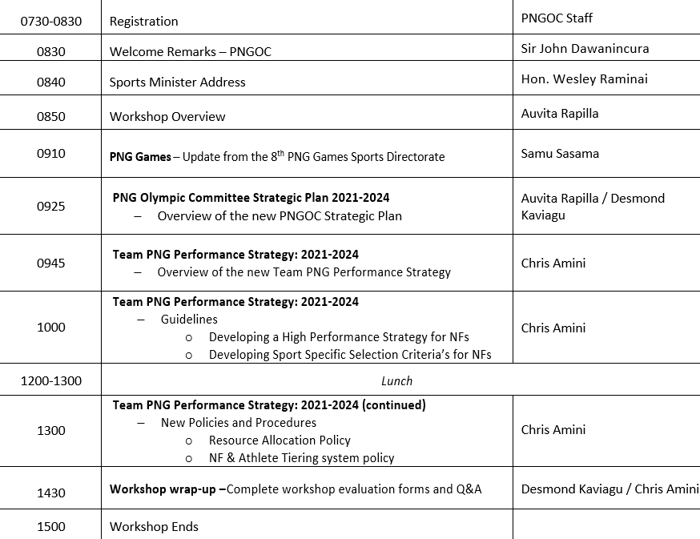
Program
Notes:
470

Slide 11
8th PNG Games Update
Sports Directorate:
Mr. Samu Sasama

Slide 12
8th PNG Games Sport Presentation
21st November– 05th December 2021
Mendi
Southern Highlands Province

Slide 13
8th PNG Games Sport Presentation
COUNT DOWN TO 2021 MENDI 8TH PNG GAMES
June – November 2021
No | Due Dates | Activities | Venue
 | May 2021 New Date to be confirmed on 5th June | Appointment of TD and TC List of Technical Officials Confirmation of Sport Equipment List Master Entry Form Sport Medal Allocation
 | 02 – 04 June 2021 | Online Sport Data Entry Workshop | Goroka
 | 05 June 2021 | PNGOC NF Sport Workshop | Port Moresby
 | 31 May 2021 | Entries by Numbers (Provinces indicate sport) | Provinces
 | 31 July 2021 | District Games | Districts
 | 31 Aug 2021 | Provincial Games | Provinces
 | 17 Sept 2021 | Final Entries by Name | Provinces
 | 27 Sept – 2 Oct 2021 | Tournament Directors Workshop | Pom
 | 4 – 7 Oct 2021 | Circulation of Draws to Provinces Circulation of Rule Books | -
 | At the Games | Sport Team Managers Meeting | Mendi

Slide 14
8th PNG Games Sport Presentation
Sport Tournament Director
No | Sport | Appointment of Tournament Director | Appointment of Technical Coordinator | List of Technical Officials | Confirm Equipment List | Master Entry Forms | Sport Medal Allocation | Tournament Rule Book
1 | Athletics |  |  |  | √ | √ | √
2 | Athletics (Para)
3 | Basketball | √ | √ |  | √ | √ | √
4 | Bowling
5 | Boxing
6 | Cricket
7 | Dart | √ | √ | √ | √ | √ | √
8 | Hockey
9 | Karate | √ |  | √ | √ | √ | √
10 | Kick Boxing | √ | √ |  | √ | √ | √ | √
11 | Netball |  |  |  |  |  | √
12 | Pool | √ | √ | √ | √ | √ | √ | √

Slide 15
8th PNG Games Sport Presentation
Sport Tournament Director
No | Sport | Appointment of Tournament Director | Appointment of Technical Coordinator | List of Technical Officials | Confirm Equipment List | Master Entry Forms | Sport Medal Allocation | Tournament Rule Book
13 | Powerlifting | √ | √ | √ | √ | √ | √ | √
14 | Power Lifting Para | √ | √ | √ | √ | √ | √ | √
15 | Rugby 7s
16 | Rugby League 9s
17 | Soccer | √ | √ | √ | √ | √
18 | Table Tennis | √ | √ | √ |  | √ | √
19 | Taekwondo |  |  |  |  |  | √
20 | Volleyball
21 | Volleyball (Beach)
22 | Weight Lifting | √ | √ |  | √ | √ | √

Slide 16
8th PNG Games Sport Presentation
8th PNG Games Number of Sport
No | Sport | Men | Women
1 | Athletics | √ | √
2 | Para Athletics | √ | √
2 | Basketball | √ | √
3 | Bowling | √ | √
4 | Boxing | √ | √
5 | Cricket | √ | -
6 | Dart | √ | √
7 | Hockey | √ | √
8 | Karate-Do | √ | √
9 | Kick Boxing | √ | √
10 | Netball | - | √
11 | Power Lifting | √ | √
 | Para Power Lifting | √ | √
No | Sport | Men | Women
12 | Rugby 7s | √ | √
13 | Rugby 9s | √ | -
14 | Soccer | √ | √
15 | Pool | √ | √
16 | Taekwondo | √ | √
17 | Table Tennis | √ | √
18 | Touch | √ | √
19 | Volleyball (Beach) | √ | √
20 | Volleyball | √ | √
21 | Weight Lifting | √ | √

Slide 17
8th PNG Games Sport Presentation
8th PNG Games Facilities
No | Facility | Sport | District
1 | Stadium, Oiyarep | Athletics Para Athletics | Mendi
2 | Nipa/Mendi | Basketball | Nipa/Mendi
3 | Bui Yebi CIS | Bowling | Mendi
4 | Western Pacific University | Boxing Taekwondo | Imbongu
5 | Walume | Cricket | Mendi
6 | Giluwe Lodge | Dart Pool | Mendi
7 | Oiyarep/ Yebi H/School | Hockey | Mendi
8 | Outdoor Stadium | Karate-Do
9 | Indoor Stadium | Kick Boxing
10 | North Mendi P/School | Netball | Mendi
No | Facility | Sport | District
11 | Tente Rugby Oval | Rugby 7s Rugby 9s | Mendi
12 | Kagua/ Momei | Soccer | Kagua/ Mendi
13 | Oiyarep | Table Tennis | Mendi
14 | Yaken P/School | Touch
15 | Oiyarep Outdoor | Volleyball (Beach) | Mendi
16 | Tente/ Kumin P/School | Volleyball | Mendi
17 | Kiburu Lodge | Weight Lifting Power Lifting Para Power Lifting | Mendi

Slide 18
8th PNG Games Sport Presentation

Slide 19
Numerical Entries by Sport
Province:___________________________
Numerical Sport Entry Form (Athletes & Officials)
No | SPORT | Team Participate (entry by sport) (√) | Maximum number allowed- Athletes | Total Athletes (entry by numbers) | Maximum number allowed -Officials | Total Officials (entry by numbers) | Sport Maximum | Sport Team
 |  | Men | Women | Men | Women | Men | Women | Men | Women | Men | Women | Total | Total
1 | Athletics |  |  | 63 | 63 |  |  | 5 | 5 |  |  | 136
2 | Athletics (Para) |  |  | ??? | ??? |  |  | ??? | ???
3 | Basketball |  |  | 12 | 12 |  |  | 2 | 2
4 | Bowling |  |  | ??? | ??? |  |  | ??? | ???
5 | Boxing |  |  | 10 | 9 |  |  | 3 | 3
6 | Cricket |  |  | 15 | - |  |  | 3 | -
7 | Dart |  |  | 15 | 15 |  |  | 2 | 2
8 | Hockey |  |  | 18 | 18 |  |  | 4 | 4
9 | Karate |  |  | 17 | 14 |  |  | 2 | 2
10 | Kick Boxing |  |  | 12 | 4 |  |  | 3 | 1
11 | Netball |  |  | - | 12 |  |  | - | 3
12 | Pool |  |  | 3 | 3 |  |  | 2 | 1
13 | Powerlifting |  |  | 8 | 7 |  |  | 2 | 1
14 | Power Lifting Para |  |  | ??? | ??? |  |  | ??? | ???
15 | Rugby 7s |  |  | 15 | 15 |  |  | 3 | 3
16 | Rugby 9s |  |  | 15 |  |  |  | 3 | -
17 | Soccer |  |  | 22 | 22 |  |  | 3 | 3
18 | Table Tennis |  |  | ??? | ??? |  |  | ??? | ???
19 | Taekwondo |  |  | 8 | 8 |  |  | 2 | 2
20 | Volleyball |  |  | 12 | 12 |  |  | 3 | 3
21 | Volleyball (Beach) |  |  | 2 | 2 |  |  | 1 | 1
22 | Weight Lifting |  |  | 6 | 6 |  |  | 2 | 1
 |  |  | Total | 253 | 222 |  | Total | 44 | 37 |  |  | 556

Slide 20
MENS
8th PNG Games Sport Presentation
Award – Sport Medal Allocation
TEAM SPORT MEDAL ALLOCATION
 |  | MENS |  |  |  |  | WOMENS
No | Team Sport | Gold | Silver | Bronze | Total |  | Gold | Silver | Bronze | Total
1 | Basketball | 12 | 12 | 12 | 36 |  | 12 | 12 | 12 | 36
2 | Beach Volleyball | 2 | 2 | 2 | 6 |  | 2 | 2 | 2 | 6
3 | Cricket | 15 | 15 | 15 | 45
4 | Hockey | 18 | 18 | 18 | 54 |  | 18 | 18 | 18 | 54
5 | Netball |  |  |  |  |  | 15 | 15 | 15 | 45
6 | Rugby League 9's | 15 | 15 | 15 | 45
7 | Rugby Union 7's | 15 | 15 | 15 | 45 |  | 15 | 15 | 15 | 45
8 | Soccer | 22 | 22 | 22 | 66 |  | 22 | 22 | 22 | 66
9 | Touch Football | 14 | 14 | 14 | 42 |  | 14 | 14 | 14 | 42
10 | Volleyball | 12 | 12 | 12 | 36 |  | 12 | 12 | 12 | 36
 | Total | 125 | 125 | 125 | 375 |  | 110 | 110 | 110 | 330
Total Medals: 705

Slide 21
MENS
8th PNG Games Sport Presentation
Award – Sport Medal Allocation
INDIVIDAUL SPORT MEDAL ALLOCATION
 |  | MENS |  |  |  |  | WOMENS
No | Team Sport | Gold | Silver | Bronze | Total |  | Gold | Silver | Bronze | Total
1 | Athletics | 28 | 28 | 28 | 84 |  | 28 | 28 | 28 | 84
2 | Bowling | 10 | 10 | 10 | 30 |  | 10 | 10 | 10 | 30
3 | Boxing | 10 | 10 | 20 | 40 |  | 9 | 9 | 18 | 36
4 | Dart | 15 | 15 | 15 | 45 |  | 15 | 15 | 15 | 45
5 | Kickboxing | 12 | 12 | 12 | 36 |  | 4 | 4 | 4 | 12
6 | Karate | 17 | 17 | 17 | 51 |  | 14 | 14 | 14 | 42
7 | Powerlifting | 8 | 8 | 8 | 24 |  | 7 | 7 | 7 | 21
8 | Pool | 5 | 5 | 5 | 15 |  | 5 | 5 | 5 | 15
9 | Table Tennis | 5 | 5 | 5 | 15 |  | 3 | 3 | 3 | 9
10 | Taekwondo | 24 | 24 | 24 | 72 |  | 24 | 24 | 24 | 72
11 | Weightlifting | 18 | 18 | 18 | 54 |  | 18 | 18 | 18 | 54
12 | Para Athletics | 16 | 16 | 16 | 48 |  | 12 | 12 | 12 | 36
13 | Para Powerlifting | 2 | 2 | 2 | 6 |  | 2 | 2 | 2 | 6
 | Total | 170 | 170 | 180 | 520 |  | 151 | 151 | 160 | 462
Total Medals: 982

Slide 22
8th PNG Games Mendi, Southern Highlands Province
Sport Competition Schedule Date: 21st November – 05th December 2021
 |  |  | Sat | Sun | Mon | Tues | Wed | Thurs | Fri | Sat | Sun | Mon | Tues | Wed | Thurs | Fri | Sat | Sun
No | Sport | Venue | 20/11 | 21/11 | 22/11 | 23/11 | 24/11 | 25/11 | 26/11 | 27/11 | 28/11 | 29/11 | 30/11 | 01/12 | 02/12 | 03/12 | 04/12 | 05/12
1 | Athletics | Oiyarep Stadium
 | Athletics (Para
2 | Basketball | Mendi
 |  | Nipa
3 | Bowling | BuiYebi - CIS
4 | Boxing | Indoor Stadium
5 | Cricket | Walume
6 | Dart | Giluwe Lodge
7 | Hockey | Oiyarep Stadium
 |  | BuiYebi - CIS
8 | Karate | Outdoor Stadium
9 | Kick Boxing | Indoor Stadium
10 | Netball | North Mendi Primary School
11 | Powerlifting | Kiburu Lodge
 | Powerlifting (Para) | Kibuuru Lodge
12 | Rugby 9s | Tente Rugby Field
13 | Rugby 7s | Tente Rugby Field
14 | Soccer | Kagua Erave
 |  | Momei
15 | Snooker | Giluwe Lodge
16 | Taekwondo | Western Pacific University
17 | Table Tennis | Oiyarep
18 | Touch Footy | Yaken Primary School
19 | V/ball Indoor | Tente Primary School
 |  | Kumin Primary School
20 | V/ball Beach | Oiyarep (Outdoor)
21 | Weightlifting | Kiburu Lodge (Indoor)

Slide 23
8th PNG Games Sport Presentation
8th PNG Games Sport Directorate
NSI Goroka
EHP
Contacts
Mobile: 70940680
78552591
Phone: 5322391
Email: 8thpnggames@pngnsi.org.pg

Slide 24
8th PNG Games Sport Presentation
Thank you
Samu Sasama
Sport Director
8th PG Games Mendi SHP

Slide 25
National Federation Workshop
PNGOC Strategic Plan: 2021-2024

Slide 26
STRATEGIC PLAN
2021-2024
Notes:
The Strategic Plan being presented today will provide direction to the Papua New Guinea Olympic Committee (PNGOC) over the current Olympiad.
It lays out the goals the PNGOC aims to achieve over the next four year period of 2021-2024.
It was developed through a consultative process which involved reviewing the performance of the PNGOC in its last strategic period (2016-2020), receiving input from member National Sport Federations (NFs) and its key government partner, the Papua New Guinea Sports Foundation (PNGSF) and involving the organisation’s staff and executive board members through workshops and working committees.
It is complimented by a monitoring and evaluation framework and risk management matrix. Annual operational plans will be developed to set out the implementation and resourcing of the strategic plan.
The strategic plan is intended to be adaptive and when deemed appropriate will be modified to reflect changes in context and the evolving needs of the PNGOC and its stakeholders.
The PNGOC is the recognised National Olympic Committee (NOC), Commonwealth Games Association (CGA) and Pacific Games Association (PGC) for Papua New Guinea; as such it is responsible for sending Team PNG to the Olympic Games, Olympic Youth Games, Commonwealth Games, Commonwealth Youth Games, Pacific Games and Pacific Mini-Games.
We are 1 of 206 NOCs and 1 of the 17 members of the ONOCs

Slide 27
OUR VISION
“Inspire and Unite Papua New Guinea through Sporting Excellence and Success”
Notes:
Our vision reflects our long-term aspiration
Our previous Vision (2016-2020) was to “Inspire and Unite Papua New Guineans”, and this has been refined to “Inspire and Unite Papua New Guinea” under the 2021-2024 Strategic Term for inclusivity and to acknowledge the contribution that sport has towards Nation Building as focused on in KRA4 – Sport in Society

Slide 28
OUR MISSION
to be “A respected and leading values-based National Olympic Committee empowering athletes and National Federations by strategically partnering with Government and key stakeholders to achieve Team PNG success.”
Notes:
Our Mission answers the questions of:
Why do we exist?
What function or service do we provide?
Who do we serve?
How do we do this?

Slide 29
OUR VALUES
HONESTY – To be truthful to others and ourselves
EXCELLENCE – To consistently give our best and improve everyday
RESPECT – To demonstrate respect for all
OPENNESS – To be transparent and accountable
Notes:
Our values are an integral part of our direction as highlighted in our mission
These are the non-negotiable principles of Honesty, Excellence, Respect and Openness that apply to the Board, Management, Staff and Members of the PNGOC
These values from the 2016-2020 period will remain the same as they create the culture of the organisation, and reflect how everyone it applies to should act to live out our mission

Slide 30
OUR KEY RESULT AREAS
KRA 1 – Excellence Embodied and Strategic Partnerships
KRA 2 – Consistent success for Team PNG
KRA 3 – Develop the Solidarity amongst and Capability of National Federations and Athletes
KRA 4 – Sport in Society
Notes:
Under the new plan we have 4 Key Result Areas as opposed to 5 in the 2016-2020 Strategic Plan
The 4 KRAs are the strategic priorities and broad areas of delivery that we will focus on in terms of delivery to our members and stakeholders in this new term
These broad areas cover considerations from the:
National Sports Policy 2020-2050
Olympic Movement (Agenda 2020+5)
ONOCs Strategic Plan (2018-2021)
Commonwealth Games Federation Transformation 2022 Refresh
You will note that our work serves the three different games movements, the:
Olympic Movement
Commonwealth Games; and
Pacific Games; and
As a key partner in the delivery of sport in PNG in line with Vision 2050 of the National Sports Policy

Slide 31
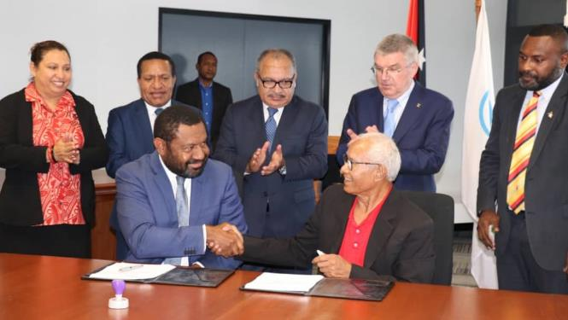
KRA 1 – Excellence Embodied and Strategic Partnerships
The PNGOC is recognised for its excellence in upholding standards, maintaining integrity, ensuring growth and sustainability, practicing inclusiveness and equity, cultivating experience and being a trusted and active partner with the Government of PNG and member of the international games movements

Slide 32
KRA 1 – Excellence Embodied and Strategic Partnerships
FOCUS AREAS
PICTURE OF SUCCESS
Governance and Management
Commercial Program
Sponsorship and Fundraising Activities
Engaging and informative communications
Employee retention, welfare and development
Sustainability, knowledge capture and continual growth
Sports integrity
Relationship with PNGSF/GoPNG
Contributing to Olympic, Commonwealth and Pacific Games Movements
Explore Strategic Partnerships
Positive results from Board and Committee Members annual performance reviews
Unqualified audit finding on annual audit report
Annual General Meeting held in full compliance with PNGOC Rules of Association
Commercial revenue generated to cover annual PNGOC budget
Significant increase in PNGOC social media following
Issues of sports integrity are dealt with in adherence to established processes
PNGOC is a valued partner of the PNGSF
PNGOC is recognized as an active member within the Games movements
PNGOC has benefited from support of new partners
Notes:
These are our focus areas under KRA1
They are all driven by standards from the various games movements we are involved in, and the work of the PNG National Sports Policy
Our job is to strengthen the Olympic Movement through Good Governance
Governance and Management comes from the IOCs Working principles of Autonomy, Governance and Sustainability
Innovative Revenue General Model is a recommendation from the IOC 2020+5 Agenda which will be captured in our revised Commercial Program (this includes sponsorship and fundraising activities)

Slide 33
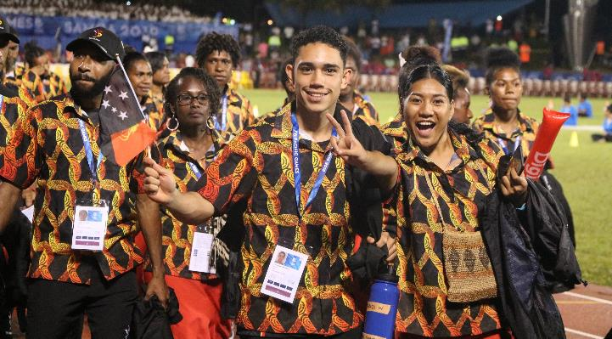
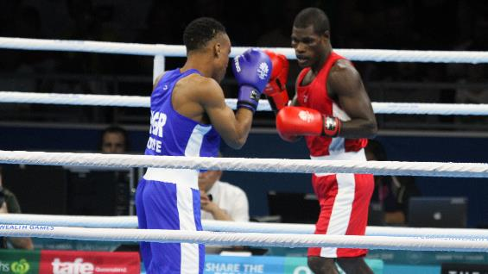
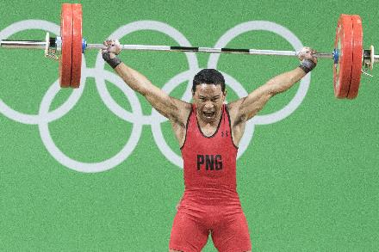
KRA 2 – Consistent success for Team PNG
Team PNG is consistently the best performing Pacific nation at all major multi-sport competitions it competes in
Notes:
KRA2 is focused on the success of Team PNG and how we will maintain that success
It is an important focus area that we have developed its own Performance Strategy for Team PNG which will be presented by Chris Amini

Slide 34
KRA 2 – Consistent success for Team PNG
FOCUS AREAS
PICTURE OF SUCCESS
National High Performance Partnership
Performance Based Standards
Development Pathways
Support to targeted elite athletes
Elite Performance Expertise
Team PNG has achieved its targets at various Games
National Federations have achieved their Games targets aligned to Team PNG targets
Athletes have achieved medal performance targets
Team PNG Games Performance Strategy targets are met

Slide 35
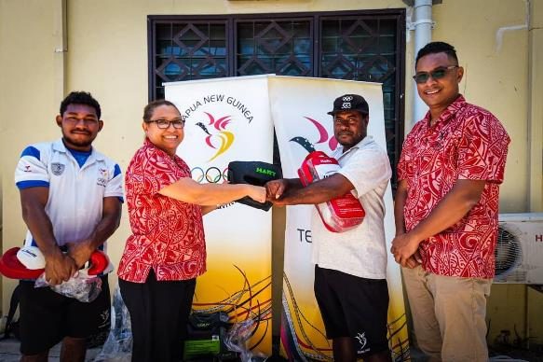
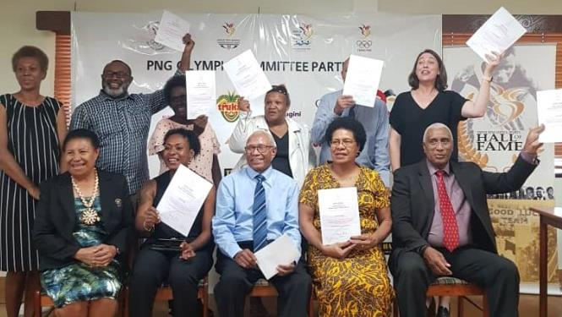
KRA 3 – Develop the Solidarity amongst and Capability of National Federations and Athletes
National Federations and Athletes are benefiting from and contributing to PNGOC programs

Slide 36
KRA 3 – Develop the Solidarity amongst and Capability of National Federations and Athletes
FOCUS AREAS
PICTURE OF SUCCESS
Compliance and sustainability
Supporting NFs with resourcing
Support in areas related to well-being for athletes and NF volunteers
Leadership in sport
NFs govern their sport in compliance with their constitutions
NFs have secured more sponsorship from sources other than PNGOC
Performance of NFs and athletes has improved from access to better equipment and resources
Any safeguarding incidents within sports are dealt with appropriately and efficiently
Athletes have successfully achieved their goals outside of sport
Athletes views are adequately represented and heard within their sport
Notes:
As per the IOC/CGF/PGC recommendations, together we will work towards:
Strengthening your governance and sustainability
Empowering and equipping your athletes (.i.e. leadership/job opportunities/welfare/life after sport)
Strengthen safe sports and the protection of clean athletes (.i.e. having policies in place like a code of conduct, athlete safeguarding)
Forming a leadership community within each NF

Slide 37
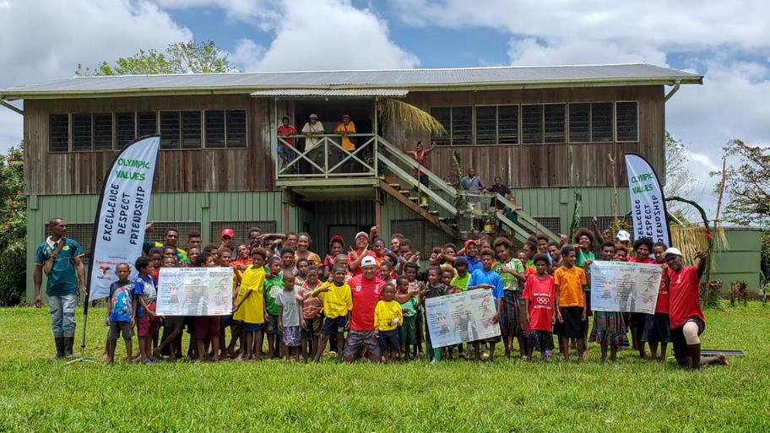
KRA 4 – Sport in Society
PNGOC uses and promotes sport as an enabler for sustainable development

Slide 38
KRA 4 – Sport in Society
FOCUS AREAS
PICTURE OF SUCCESS
Promote Olympism and the various games movements
Use sport to support the awareness and achievement of the Sustainable Development Goals (SDGs)
Ensure the participation for sport for all
Knowledge of Olympism has increased amongst members of general public
Knowledge of the Commonwealth Games and Pacific Games movements has increased amongst members of general public
Sport is acknowledged for contributing to the achievement of SDG targets in PNG
More children, including girls and children with a disability, are participating in structured sporting activities
Notes:
Under KRA4 we realise the power of Sport and our Athletes/Young People to use and promote sport as an enabler of sustainable development
Graduates of the HEROs programs are running OVEP outreach programs across the country
Awareness raising of shared community values such as
respect for gender equality
Fight against the use of drugs in sport

Slide 39
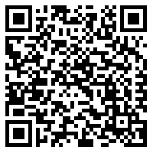
THANK YOU
Available for download on the PNGOC Website or scan the following QR code

Slide 40
Games Planning Workshop
Team PNG Performance Strategy: 2021-2024
Notes:
Will go over data related to appeals received. Then present issues and solutions the JC has identified and finish with sharing the proposed revised JC process maps for 2023 Pacific Games.

Slide 41
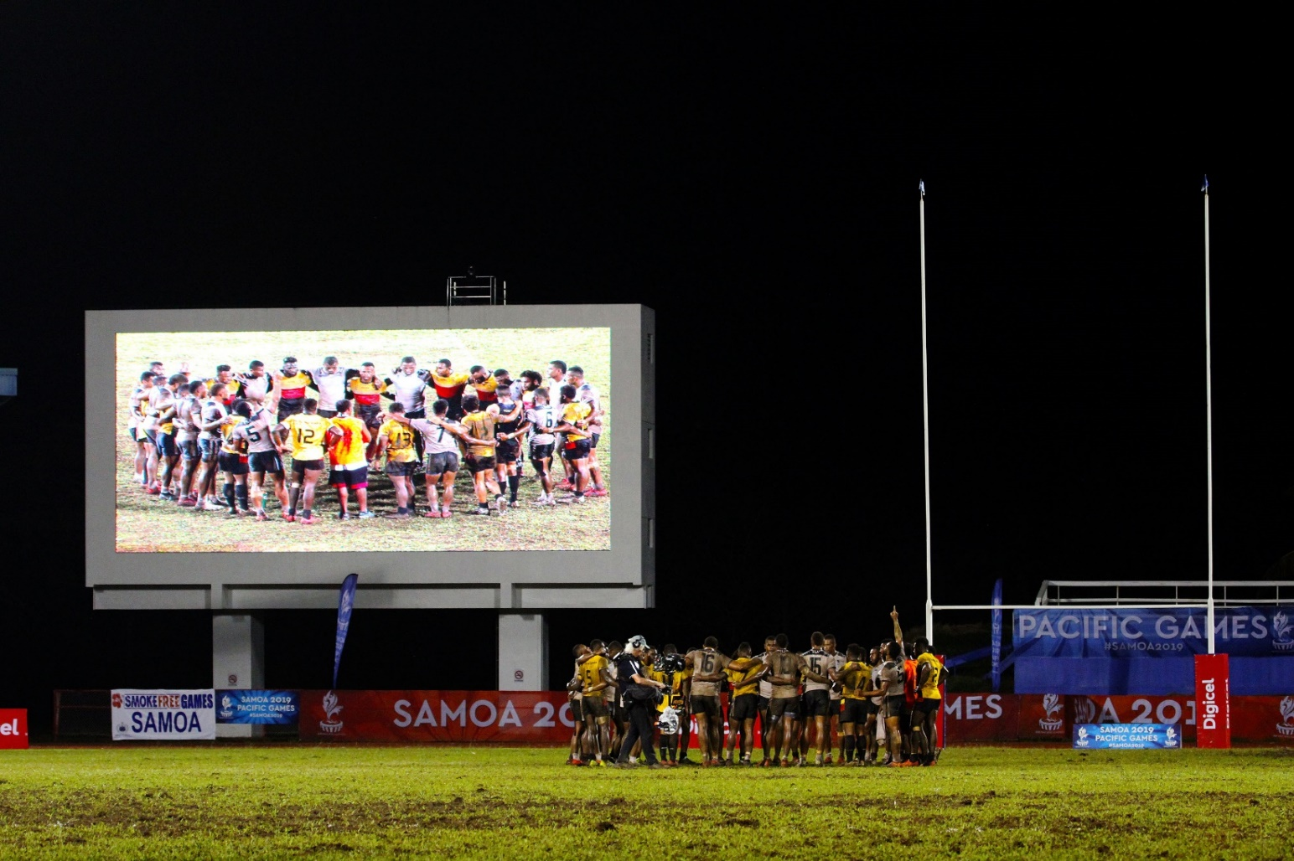
If you do what you’ve always done, you’ll get what you’ve always gotten
- Tony Robbins

Slide 42
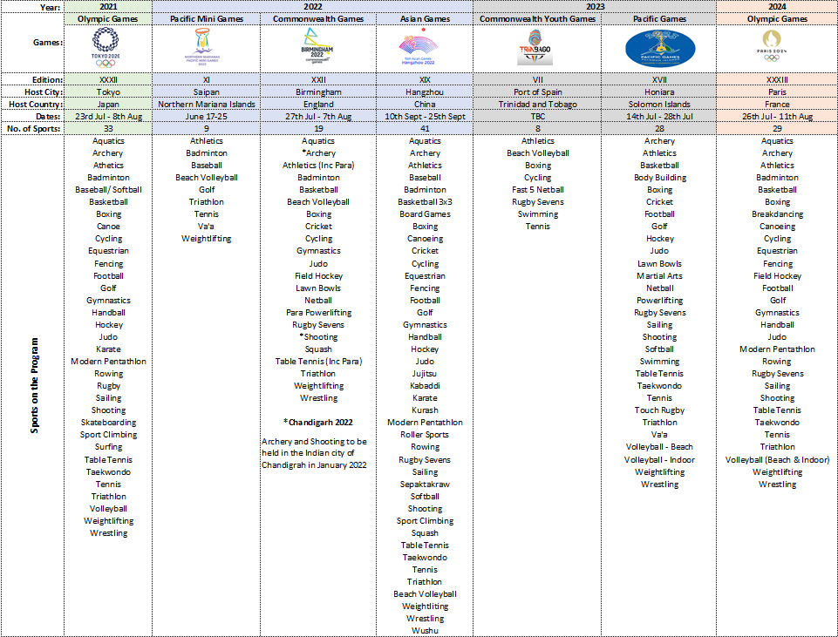
List games on the program
2021-2024
― Asi to run an acitivity

Slide 43
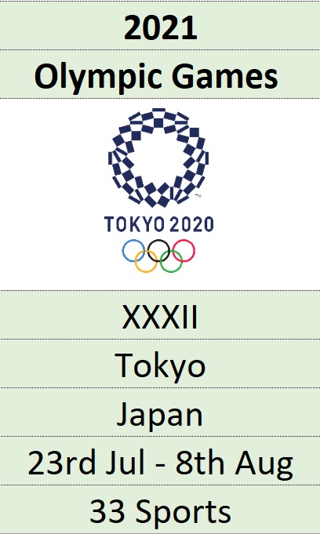
Games - 2021

Slide 44
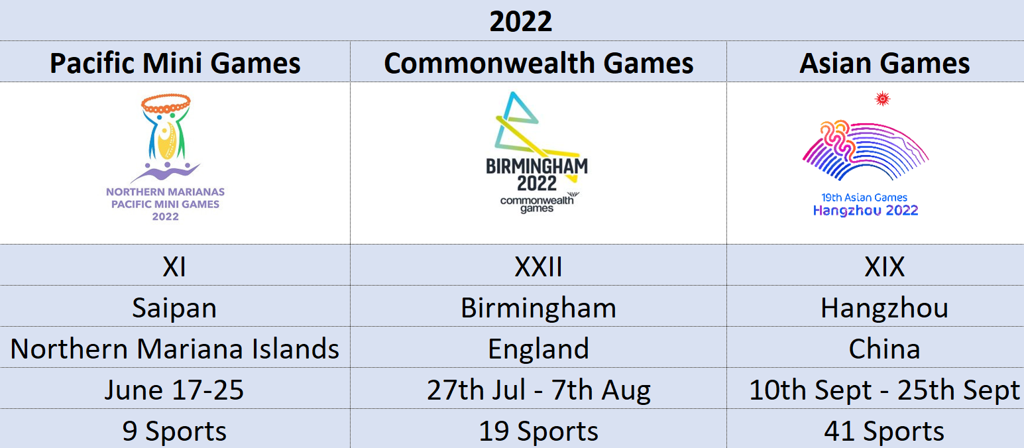
Games - 2022

Slide 45
Games - 2023

Slide 46
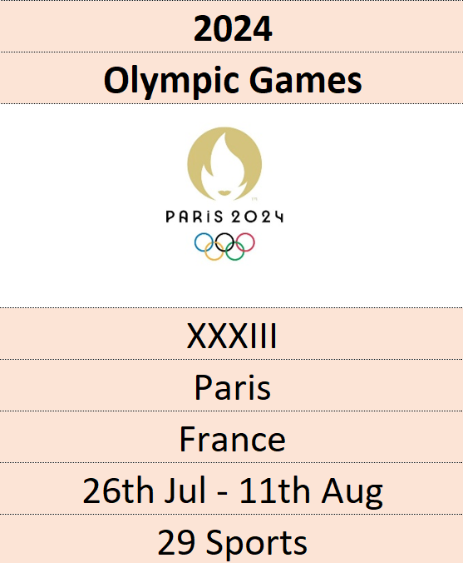
Games - 2024

Slide 47
Where is Team PNG trying to end up?

Slide 48
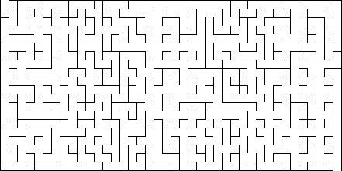

Slide 49
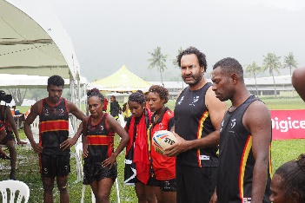
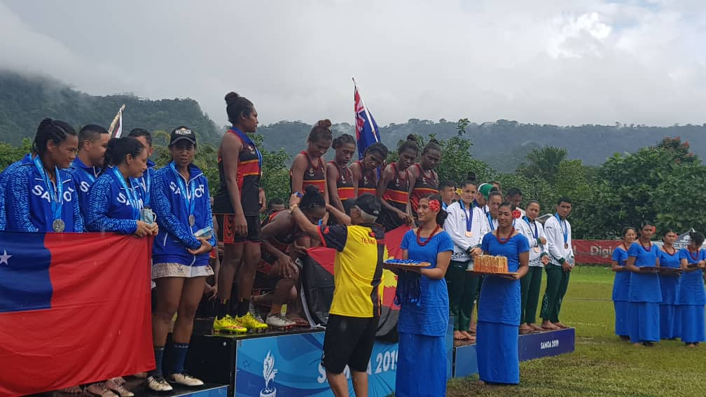
How do we get there?

Slide 50
How was it developed?
February 2020 – January 2021
Led by Dr Peter Davis and Chris Amini
Stakeholder consultations
Athletes
NF leaders
Coaches
Integrated Support Team (SS/SM) & Partners (PNGSF/NSI/HP Sport)
PNGOC Staff

Slide 51
How do we get there?
Guided by:
Team PNG Performance Strategy developed [2021-2024]
Developed to achieve the overarching goal and Key Result Area # 2 (Consistent Success for Team PNG) in the overall PNGOC Strategic Plan

Slide 52
Team PNG Overarching Goal
Overarching Goal:
By 2023/24, PNG will consistently be the best performing Pacific nation in all major multi-sport competitions including, but not limited to, Olympic Games, Pacific Games, mini-Pacific Games, Youth Olympic Games and Commonwealth Games.

Slide 53
Team PNG Performance Strategy - Overview
2021-2024 Overview:
Programs

Slide 54
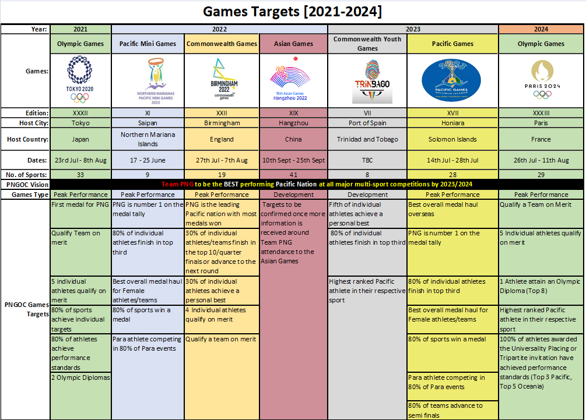
The Process – How do you get supported?
Notes:
Tokyo:
First medal for PNG
Qualify Team on merit
5 individual athletes qualify on merit
80% of sports achieve individual targets
80% of athletes achieve performance standards
2 Olympic Diplomas
Pacific Mini Games:
PNG is number 1 on the medal tally
80% of individual athletes finish in top third
Best overall medal haul for Female athletes/teams
80% of sports win a medal
Para athlete competing in 80% of Para events
Commonwealth Games:
PNG is the leading Pacific nation with most medals won
30% of individual athletes/teams finish in the top 10/quarter finals or advance to the next round
30% of individual athletes achieve a personal best
4 Individual athletes qualify on merit
Qualify a team on merit
Asian Games:
Targets to be confirmed once more information is received around Team PNG attendance to the Asian Games
CYG:
Fifth of individual athletes achieve a personal best
80% of individual athletes finish in top third
Highest ranked Pacific athlete in their respective sport
Pacific Games:
Best overall medal haul overseas
PNG is number 1 on the medal tally
80% of individual athletes finish in top third
Best overall medal haul for Female athletes/teams
80% of sports win a medal
Para athlete competing in 80% of Para events
80% of teams advance to semi finals
Paris2024:
Qualify a Team on Merit
5 Individual athletes qualify on merit
1 Athlete attain an Olympic Diploma (Top 8)
Highest ranked Pacific athlete in their respective sport
100% of athletes awarded the Universality Placing or Tripartite invitation have achieved performance standards (Top 3 Pacific, Top 5 Oceania)

Slide 55
Games Targets – 2021
Tokyo2020 Olympic Games:
Win first medal for PNG
Qualify a team on merit
5 individuals qualify on merit
80% of sports achieve individual targets
80% of athletes achieve performance standards
2 Olympic Diplomas

Slide 56
Games Targets - 2022
Northern Marianas Pacific Mini Games 2022:
PNG is number 1 on the medal tally
80% of individual athletes finish in top third
Best overall medal haul for Female athletes/teams
80% of sports win a medal
Para athlete competing in 80% of Para events
Birmingham2022 Commonwealth Games:
PNG is the leading Pacific nation with most medals won
30% of individual athletes/teams finish in the top 10/quarter finals or advance to the next round
30% of individual athletes achieve a personal best
4 Individual athletes qualify on merit
Qualify a team on merit
Hangzhou 2022 Asian Games
Targets to be confirmed once more information is received around Team PNG attendance to the Asian Games

Slide 57
Games Targets - 2023
2023 Commonwealth Youth Games
Fifth of individual athletes achieve a personal best
80% of individual athletes finish in top third
Highest ranked Pacific athlete in their respective sport
Solomon Islands 2023:
Best overall medal haul overseas
PNG is number 1 on the medal tally
80% of individual athletes finish in top third
Best overall medal haul for Female athletes/teams
80% of sports win a medal
Para athlete competing in 80% of Para events
80% of teams advance to semi finals

Slide 58
Games Targets – 2024
Paris2024:
Qualify a Team on Merit
5 Individual athletes qualify on merit
1 athlete attain Olympic Diploma
Highest ranked Pacific athlete in their respective sport
100% of athletes awarded the Universality Placing or Tripartite invitation have achieved performance standards (Top 3 Pacific, Top 5 Oceania)

Slide 59
Performance Standards

Slide 60
Team PNG Performance Strategy
By 2023/24, PNG will consistently be the best performing Pacific nation in all major multi-sport competitions
Eighteen Programs across five focus areas:
National High Performance Partnership
Support to targeted Elite Athletes
Performance Based Standards
Development Pathways
Elite Performance Expertise

Slide 61
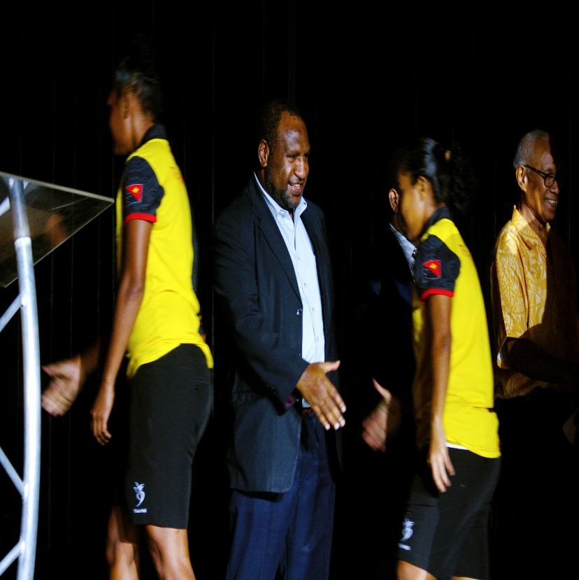
National High Performance Partnership
Objectives:
Lead & facilitate formation of a High Performance partnership
Comprised of key stakeholders (Sports Ministry, PNGOC, PNGSF, NFs);
Develop & coordinate national High Performance programs designed to achieve overarching goal

Slide 62
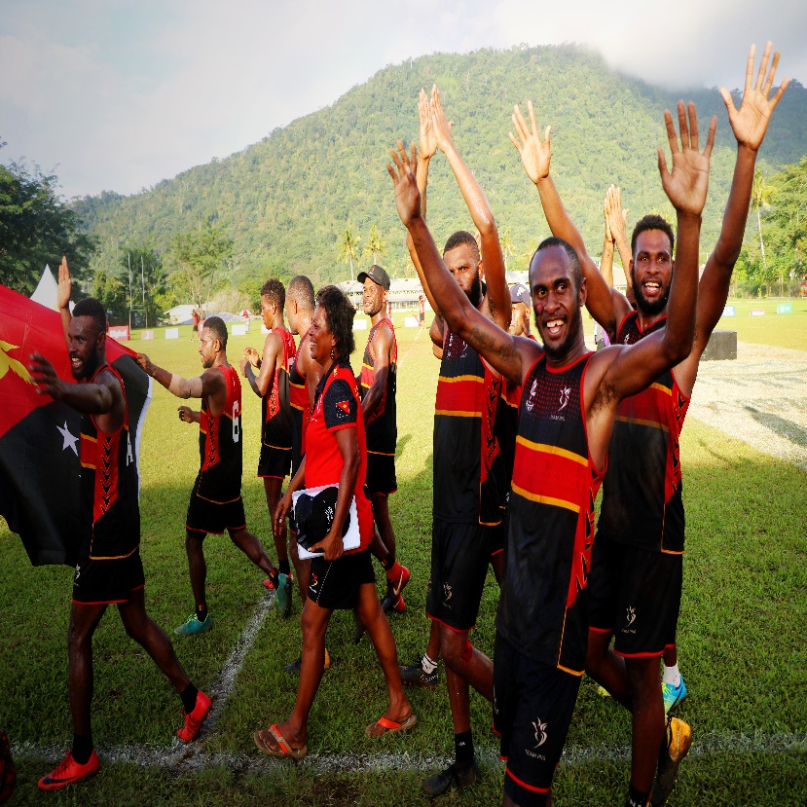
Support to targeted Elite Athletes
Objectives:
Elite preparation programs targeting SI2023 (Team 2023) and Paris2024 (Team 2024)
Athletes and coaches that are familiar with the Games environment and Team PNG performance and behaviour standards

Slide 63
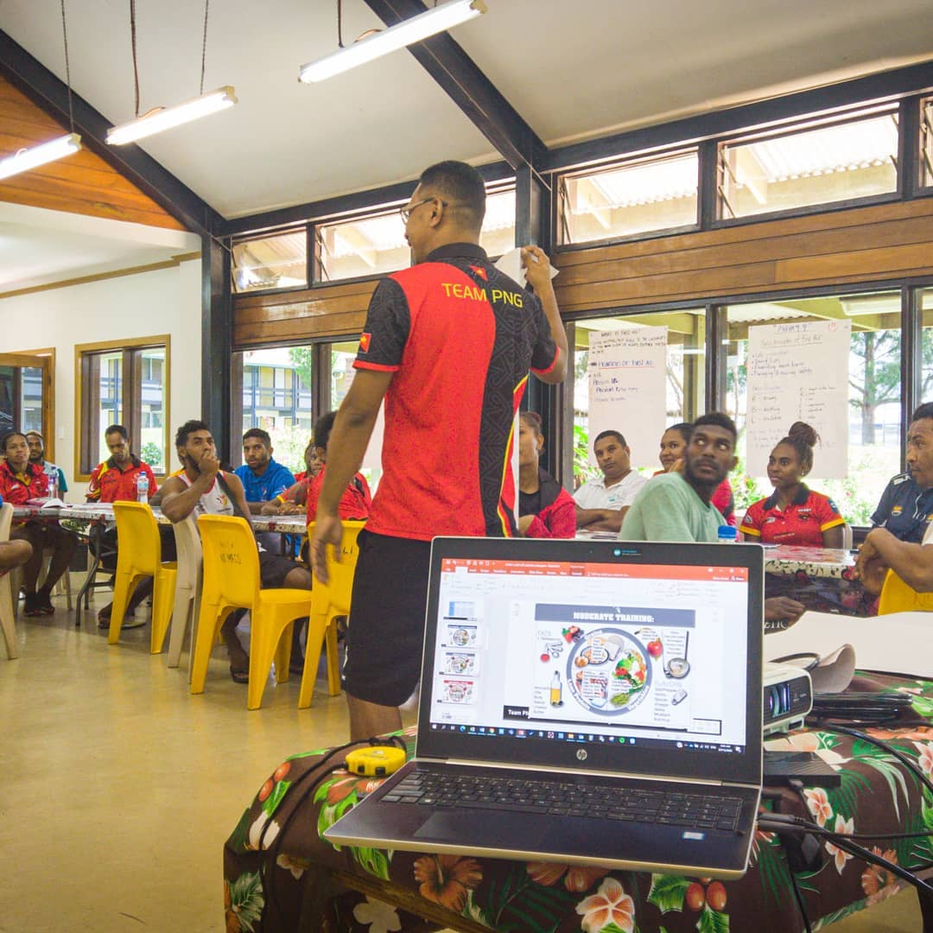
Development Pathways
Objectives:
Initiatives for elite coaches - Retention, development, recruitment and succession
High level domestic competitions for athletes and coaches;
Talent ID and recruitment program which are aligned to NFs and PNGSF programs;

Slide 64
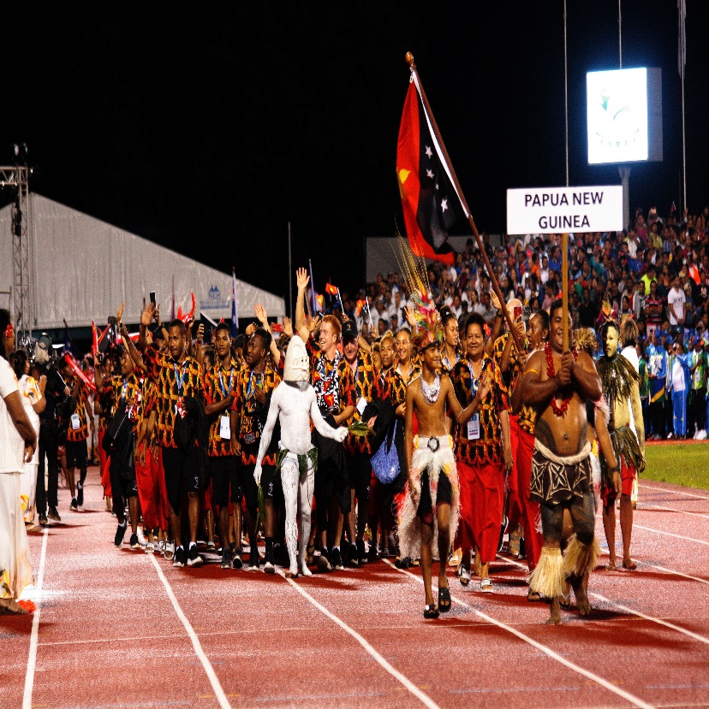
Performance Based Standards
Objectives:
Transparent Selection policies to nominate athletes/officials for Team PNG
Team PNG selection & justification process is conducted in a fair & transparent manner
Funding strategically provided to sports & athletes;
Annual tiering of sports based on performance

Slide 65
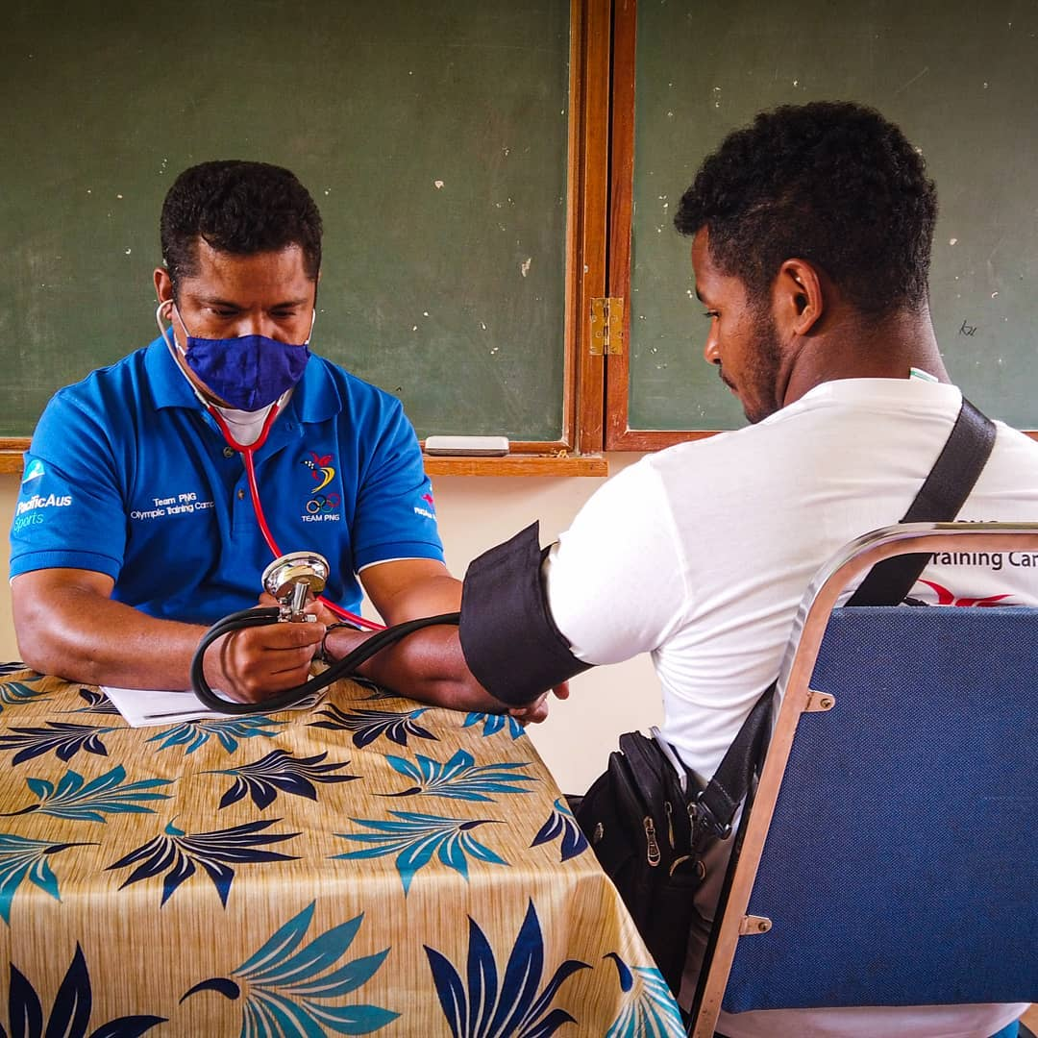
Elite Performance Expertise
Objectives:
Internal capacity to conduct elite level performance analytics
Enhancement of Sports Science and Sports Medicine capacity that is comparable to international standards and based on local research

Slide 66
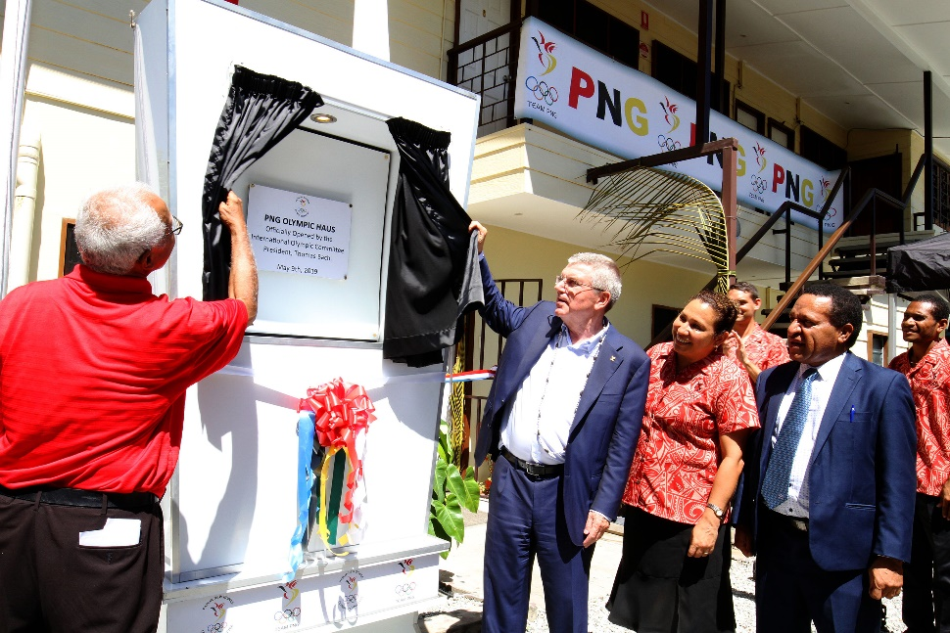
Who are our partners?
Stakeholders / Partners:
PNG Government
Sports Ministry
PNG Sports Foundation – HP Sport, NSI
National Federations
Corporate Partners
International Partners
IOC / CGF / PGC
International Federations
DFAT / AOC

Slide 67
There is no next time, no time-outs, no second chances. Sometimes it’s now or never - Unknown

Slide 68
Team PNG Performance Strategy: 2021-24
New Policies and Procedures

Slide 69
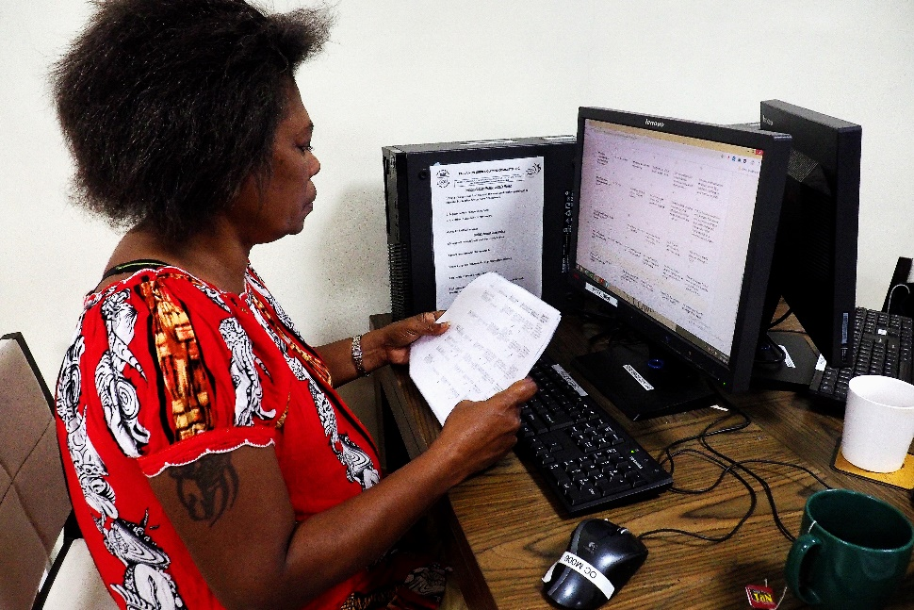
The Process – How do you get supported?
Funding Support – The process:
Developing High Performance Strategy for National Federations
Developing Sport Specific Selection Criteria for NFs
Athletes/Teams are Tiered
Resources allocated
Reporting and acquittals
Monitoring & evaluating

Slide 70
Process to support NFs, Athletes and Teams
NF develops HP Plan & Selection criteria
Joint re-planning of presented plans
PNGOC Guidelines:
1. NF Sport Specific Selection Criteria
2. HP Strategic Plan development
NF presents evidence-based plan & selection criteria to PNGOC
HP Plan Template
& Signed off Team PNG Selection Policy
JC requirements for justification of sport:
NF Selection criteria
NF HP Plan
List of targeted athletes & officials
PNGOC reviews plan and determines if Quality is POOR or GOOD
POOR. NF amends plans based on collaborated discussions
GOOD. Proceeds to Resources being allocated
NFs & athletes ranked according to NF & Athletes Tiering System Policy
NF executes plan
Funds and resources provide to NF
Program review and evaluation (annually)
Resource Allocation Policy

Slide 71
PNGOC Resource Allocation Overview: 2021-2024
According to NF HP Plan development Guidelines
NF submits High Performance Plan & Selection Policy
According to NF & Athlete Tiering System policy
NF /athletes / teams ranked
PNGOC reviews plans and allocates resources
According to Resource Allocation Policy

Slide 72
NF & Athlete Tiering System and Resource Allocation process
PNGOC evaluates NF and submitted list of athletes based on the evaluation criteria's & their HP Plan
NF evaluates themselves based on the criteria’s and provides evidence to justify their evaluations
PNGOC and NF reviews (annually) the scores and arrives at a final agreed score
Resources are allocated according to Resources Allocation Policy (RAP)
NF Executes the plans
Final score determines the ranking tier for that NF
PNGOC will provide ranking in specific areas of sport performance.
Focused on preparation for and performance at PG, CG, OLY
Reviewed annually
Evidence must be provided
Scores weighted according to impact of criteria to achieve PNGOC & NF targets

Slide 73
Team PNG Selection Process
PNGOC designs Athlete/Official Selection Policy and Selection Guidelines for NFs
Based on PNGOC Selection Guidelines
NFs develops their own Sport Specific criteria/policy for the quadrennial
NOT APPROVED
Initial design process. Reviewed every 2 years
PNGOC & NF publish Criteria on respective websites. NF communicates to their Athletes
PNGOC confirms that NF Criteria meets PNGOC selection guidelines
Performance Committee approves NF Criteria and PNGOC SG signs off with NF to agree on the Selection Policy
PROCESS REPEATS FOR EACH GAMES
NOT ENDORSED
JC reviews compliance with criteria (not the individuals)
NFs select athletes/teams/officials based on their criteria/policy for specific Games
Process for each Games
Selections submitted to JC
Games time
Appeal
Appeal

Slide 74
Justification Timeline
SPORT
3 YEARS Before Games
ATHLETE*
1 YEAR Before Games
GAMES TIME
OFFICIAL
2 YEARS Before Games
*For Final Squad athletes. Final Team to be confirmed by NF closer to Games

Slide 75
Endorsed
Full compliance. All requirements have been met.
N.B. Ongoing monitoring of compliance leading up to Games
Not Yet Endorsed
Partial compliance. Only some requirements have been met.
JC may request Sport re-apply for Justification once all requirements have been met. JC will fix time for full compliance e.g. 30 days. One chance only.
Sport returns for Justification within time fixed by JC.
Not Endorsed
Appeal to Sports Dispute Tribunal within 14 days of notification of decision
Sports Dispute Tribunal to hear appeal within 30 days of receiving appeal
Appeal to International Court of Arbitration of Sports within 21 days of notification of decision
Justification Committee may Endorse or Not Endorse
Sports Disputes Tribunal may Endorse or Not Endorse
APPLYING TO JUSTIFY A SPORT
Requirements:
NF Selection Criteria with names of Selection Panel if applicable and sport specific testing protocols
Provide evidence of how NF Criteria has been communicated to athletes
Sign-off of Team PNG Selection Policy
Submit preparation plan with benchmark events
Games Performance Goal

Slide 76
Endorsed
Full compliance. All requirements have been met.
N.B. Ongoing monitoring of compliance leading up to Games
Not Yet Endorsed
Partial compliance. Only some requirements have been met and/or more information required
JC may request Official’s name be re-submitted once all requirements have been met. JC will fix time for full compliance e.g. 30 days. One chance only.
Official’s name returns for Justification within time fixed by JC.
Not Endorsed
Appeal to Sports Disputes Tribunal within 14 days of notification of decision
Sports Dispute Tribunal to hear appeal within 30 days of receiving appeal
Appeal to International Court of Arbitration of Sports within 21 days of notification of decision
Justification Committee may Endorse or Not Endorse
Sports Disputes Tribunal may Endorse or Not Endorse
APPLYING TO JUSTIFY AN OFFICIAL
Requirements:
Current IF or OSEP Team Manager/Development Coach/S&C certification
Athlete Safeguarding certification
Anti-doping certification
Completed and signed nomination form
Bio-data information with soft copy photo

Slide 77
Endorsed
Full compliance. All requirements have been met.
N.B. Ongoing monitoring of compliance leading up to Games
Not Yet Endorsed
Partial compliance. Only some requirements have been met and/or more information required
JC may request Athlete’s name be re-submitted once all requirements have been met. JC will fix time for full compliance e.g. 30 days. One chance only.
Athlete’s name returns for Justification within time fixed by JC.
Not Endorsed
Appeal to Sports Disputes Tribunal within 14 days of notification of decision
Sports Dispute Tribunal to hear appeal within 30 days of receiving appeal
Appeal to International Court of Arbitration of Sports within 21 days of notification of decision
Justification Committee may Endorse or Not Endorse
Sports Disputes Tribunal may Endorse or Not Endorse
APPLYING TO JUSTIFY AN ATHLETE
Requirements:
Bio-data information with soft-copy photo
Fitness Test results
Medical Test results
Benchmark competition results
Coach to justify athletes at JC meeting

Slide 78
Team PNG Performance Strategy: 2021-24
Guidelines

Slide 79
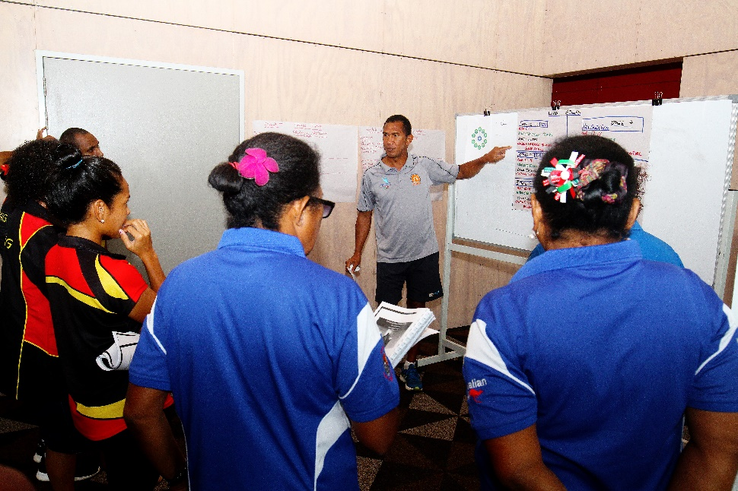
Guidelines
Guidelines developed:
Developing High Performance Strategy for National Federations
Developing Sport Specific Selection Criteria for NFs

Slide 80
Developing High Performance Strategy for NFs
Alignment to overall NF strategic plan
Stakeholder input
Values of HP Strategy
Performance History
SWOT Analysis
Goals
Programs/Activities/Events
Key Program Outcomes (at least 1 for each Program/Activity/Event)
Camps and competition calendar (and identify pinnacle or benchmark competitions)
Key performance outcomes (KPOs) for all competitions
Long list of athletes and officials
Budget
Monitoring & evaluation process
Evidence provided
Plan elements:

Slide 81
Games Planning Workshop
High Performance Planning: PNGOC Template
Notes:
Will go over data related to appeals received. Then present issues and solutions the JC has identified and finish with sharing the proposed revised JC process maps for 2023 Pacific Games.

Slide 82
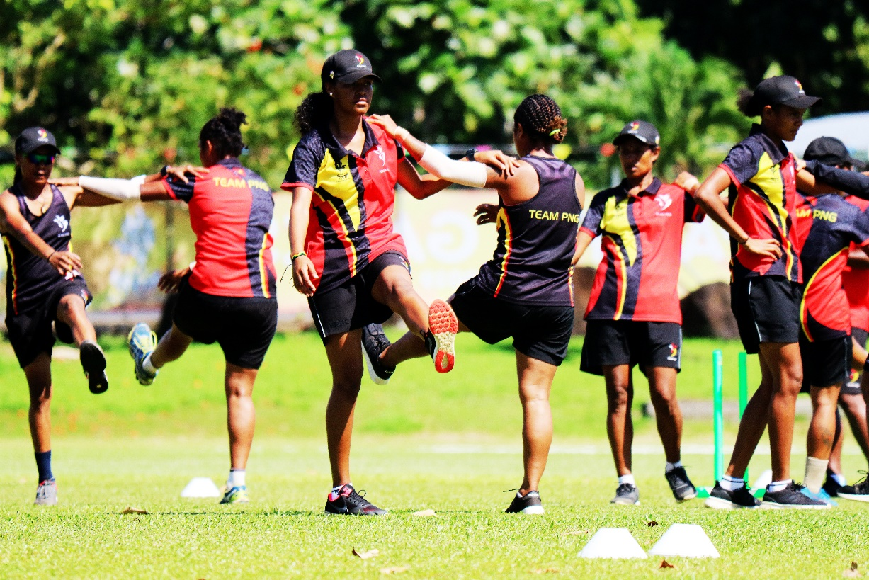
Getting the big picture, but paying attention to the details

Slide 83
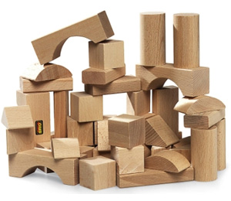
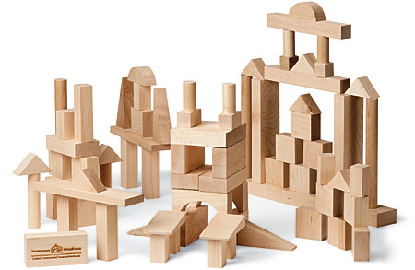
Putting things together…
Plans within a plan.

Slide 84
NF Planning template
Alignment
Stakeholder input
Values, Performance History, SWOT
Goals
Programs – Activities & Events
Key Program Outcomes
Targeted athletes/officials
Budget

Slide 85
Alignment, Stakeholder Input, Values
Alignment:
Ideally, a NFs high performance strategy should be a sub set, and align with the overall organizational strategic plan. This should include goals, budget, and alignment of policies, programs and so on.
Include stakeholders:
The NF high performance strategy should indicate who was involved in the planning process and how the planning process occurred
Values:
These should be words or statements that define how the high performance strategy will be implemented and managed over the course of the planning period

Slide 86
Performance History, SWOT,
Performance History:
This should include a performance history from major international events over the previous 4-5 years
SWOT:
This should include the TOP 3 in each category
Ideally, they will be connected to Goals and Programs and Key Programs and/or Performance Outcomes (KPOs) below

Slide 87
Goals
Goals – Questions to ask
What could we achieve if we really put our hearts and minds to it?
How far could we go if everything came together by the end of the Pacific Games 2023 / Paris2024 (Select next major games)
What kind of tournament would we like to have so that we look back on it with fondness and feel it was worth all the time and energy we put into it?
What is your picture of Success?

Slide 88
NF Planning template – Performance Goals
Performance Goals – Areas to consider:
Coaching / Entourage
Training
Competition
Athletes (Sports science/sports medicine)

Slide 89
Goals
*Outcome Goals (Out of your control)
Related to winning and losing or specific results of a competition where you want to perform better than someone else. Affected by how others perform
*Performance Goals (In your control)
Performance goals specify a specific standard to be achieved. Unaffected by others performances
Process Goals (In your control)
Things needed to do to achieve Performance Goals.

Slide 90
Programs – Activities/Events
All goals require at least one program, activity or event (that can be collectively called ‘Programs’) in order for them to be successfully achieved.
A program should fall under one of these core elements in high performance sport:
Athlete development
Coach development
Competition Management
Daily Training Environment management
Governance/Management
Sports Science/Sports Medicine

Slide 91
Key Program Outcomes
All programs should have at least one KPO to demonstrate whether the program was successfully implemented and/or whether it achieved the desired goal.
KPOs can be qualitative or quantitative.

Slide 92
Key competitions and camps
All camps and competitions must be listed in the plan including date and location and KPOs,
Pinnacle or Benchmark competitions are those that are the primary performance events of the year or the 4-year planning cycle. In addition, are usually events for which an athlete or team peaks and tapers for the event. They are required to demonstrate whether or not the plan is on track to be successfully achieved,

Slide 93
Athletes & Officials
List down all the targeted athletes by event. (This is where you will score the athletes based on the NF & athlete tiering system policy)
List down the targeted officials.

Slide 94
Budget
Budget –
How much will your plans cost?
Who are your possible sources of funding?
PNGOC is ONE source of funding
Your IF?

Slide 95
ACTIVITY
NF HP Planning Template:
Start on your own NF High Performance Strategies

Slide 96
Games Planning Workshop
Guidelines to developing Sport specific selection criteria
Notes:
Will go over data related to appeals received. Then present issues and solutions the JC has identified and finish with sharing the proposed revised JC process maps for 2023 Pacific Games.

Slide 97
Developing Sport Specific Selection Criteria for NFs
Plan elements:
Philosophy of selection policy
Goals of selection is identified for each relevant event (e.g. best possible team or development team)
Selection Panel ToR approved by Board
Nomination/appointment/election process defined and approved by NF Board
All selection panel members complete conflict of interest disclosure
Direct performance criteria are described in the selection policy
Direct performance criteria include the JC’s min performance standards for benchmark events
Indirect/secondary performance criteria are described in the selection policy
Sport Sciences/Sports Medicine criteria are described in the selection policy – Fitness testing etc
Other/subjective criteria are describe in the selection policy
Communication strategy in place that describes how, when and where selections are communicated to athlete, sport community and general public
Appeals process is clearly described in the policy

Slide 98
Philosophy
Effective selection policies and criteria start with a guiding philosophy. The philosophy should describe the general purpose of the process as well as how the process will be implemented.
The philosophy usually explains the balance between always selecting the best possible team and the athlete development process (i.e. as a way to trial and test developing athletes etc.).

Slide 99
Nomination of NF Selection Committee
Why have one?
How are they identified or selected?
Who should be part of the selection committee? Coach, external, other HP coaches, board members?
Conflict of interest? How should this be handled?
When? How long is their term for?
Responsibilities?

Slide 100
Establishing Sport specific criteria
It is essential to have objective, evidence-based criteria to justify an athlete’s selection to a team (for either an individual athlete event or selection to a team). Sport specific selection criteria can be defined by the categories below:
Direct (or primary) sport performance criteria,
Indirect (or secondary) sport performance criteria,
Sport Sciences/Sports Medicine related factors,
Other contributing performance criteria.

Slide 101
Sport specific criteria – Direct sport performance
This refers to specific “field of play” data. It can include specific results of a previous competition, achievement of a specific standard (such as a time, distance, weight etc.), a national, regional or world ranking and so on

Slide 102
Sport specific criteria – Indirect sport performance
This refers to other performance related criteria and data that can be used to help decision-making. Should not be used as the primary deciding factors for selection, contributes to the final decisions. They include elements such as:
Direction or trend of performance outcomes,
Outcomes of head to head competition with specific opposition,
Sport specific performance data – e.g. shooting % in basketball, point differential in bouts or preliminary games etc.
Other relevant data

Slide 103
Sport specific criteria – Sports Medicine/Sports Science data
This refers to specific data from the sport sciences and/or sports medicine fields including lab tests, field tests, assessments, fitness tests, medical assessment, and injury/health status and so on.
An athlete should not be selected (or not selected) based on the result of a specific field or lab test. However, sport sciences and sports medicine related data can, and should, be used to determine fitness level and readiness to compete

Slide 104
Communication
It is important to have appropriate procedures to:
Inform athletes of their selection,
Inform athletes of their non-selection,
Inform the sport community and general public of selection.
The NF selection policy and process should identify the process and timeline for how, when and where athletes and the sport community and general public will be informed of the selection outcomes.

Slide 105
Appeals Process
The NF Selection Policy should describe the appeals process for athletes. Reasons for an appeal should be described in the NF policy and may include, but not necessarily be limited to:
Using incorrect performance data,
Using incorrect secondary, Sport Sciences/Sports Medicine data or other data,
NF Selection Panel not following their own specific process.

Slide 106
ACTIVITY
NF Sport Specific selection criteria:
Start on your own NF sport specific selection criteria.
If you already have one. Use the checklist to see if you need to amend your selection policy

Slide 107
Games Planning Workshop
Policies
Notes:
Will go over data related to appeals received. Then present issues and solutions the JC has identified and finish with sharing the proposed revised JC process maps for 2023 Pacific Games.

Slide 108
NF / Athlete Tiering System Policy & Resource Allocation Policy
Purpose:
Transparent Process
HOW – How were they ranked?
WHERE – Where are they ranked?
WHY – Why are they ranked in this Tier?
WHAT – What resources are they eligible for?

Slide 109
Resource Allocation Policy
Purpose:
Allocate and disburse resources efficiently and effectively
Optimize performance outcomes at major Games.
Aligned with the Mission, Vision and Values
Aligned with the overall performance objectives
Aligned with the ‘NF and Athlete Tiering system policy (2021)’
Merged with the PNGOC ‘Sport Funding Support Policy’ (2017).
Achieve Team PNG’s Performance Strategy vision,
Achieve respective major Games targets
Achieve certain primary and secondary objectives.
Primary objective - Resources allocated in a fair, equitable, transparent and standardized manner.

Slide 110
Resource Allocation Policy
Purpose:
Tiering Policy - NFs & athletes will know HOW, WHERE and WHY they are ranked in specific tiers.
NFs and athletes know WHAT they are eligible to receive (dependent on resources).
Secondary objective - NFs and athletes understand what’s needed to improve in areas of performance
Initial Sport Funding Support Policy (2017) provided guidelines in terms of being compliant and eligible to receive funding support however; it did not specify in detail HOW, WHERE and WHY they were ranked in specific tiers and WHAT type of areas they could be supported in.

Slide 111
NF / Athlete Tiering System Policy
Purpose:
Rank and tier NFs, athletes and teams
Prioritization and efficiency of allocating resources and providing support.
Not every NF can be optimally supported in every element of high performance sport.
A guide for application of the RAP.
Collaborative process between PNGOC and NFs
Determines the status of the NF and Athletes in specific areas relevant to several critical success factors.
Combined with the RAP to achieve Team PNG’s Games Performance Strategy vision as well as respective major Games targets and certain primary and secondary objectives.

Slide 112
NF / Athlete Tiering System Policy
Purpose:
Primary objective - Resources allocated to NFs and athletes in a fair, equitable, transparent and standardized manner.
The NFs and athletes will know HOW, WHERE and WHY they are ranked in specific tiers according to published criteria.
The RAP, NFs and individual athletes will know WHAT resources they are eligible to receive (dependent on resources).
The secondary objective - NFs and athletes understand what they need to do to improve in areas of performance and/or other areas of operation according to the NF and individual athlete ranking criteria

Slide 113
Performance Evaluation Criteria’s
Evaluation criteria | Broad description of elements that can be included in this criteria
Athlete/Team performance ranking & Trend | This area will include performances in World/Olympic/ Commonwealth/Pacific ranking These criteria will consider the amount and direction of change in ranking and/or performance results.
Team 2022 – Commonwealth Games | Number of medals available at the Birmingham 2022 CWG Previous Games experience Predicted Performances
Team 2023 – Pacific Games | Number of medals available at the SI 2023 Pacific Games Previous Games experience Predicted Performances
Team 2024 – Olympic Games | Qualification Process Olympic competition structure Olympic Ranking Previous Games experience Predicted performances
Scoring:
Level 1 – 1 Point (Some have “0”points for not meeting any criteria at all)
Level 2 – 3 Points
Level 3 – 5 Points
Level 4 – 7 Points

Slide 114
Performance Evaluation Scoring – Athlete Ranking
Criteria | Level 1 | Level 2 | Level 3 | Level 4 | FINAL SCORES
 | (1 point) | (3 points) | (5 Points | (7 points)
1. Athlete ranking | This area will consider World/Olympic/Commonwealth/Pacific (or other relative) ranking. |  |  |  | Athletics |  | Rugby 7s
 | It can also consider the gap in performance levels between PNG athletes/teams and elements such as qualification standards, reaching finals or medal position for specific competitions. |  |  |  | Toea Wisil | Peniel Richard | Women’s Team | Men’s Team
 | Ranked lower than 3 in PNG (for individual sports) | Ranked 6-15 in Oceania, or | Top 5 ranked in Pacific or Oceania, or | In Top 100 world ranking, or | 7 | 7 | 5 | 3
 | Team sport ranked >16 Oceania or Pacific ranking | Top 6-15 Pacific ranking, or | Finish in top 3rd of field third finish at most recent C/wealth Games, or | Top 3 in Oceania or
 |  | Top 3 ranked in PNG |  | Has met Olympic A or B standard or
 |  |  | Podium finish at most recent Pacific Games | Has won Gold at most recent Pacific Games
 |  |  |  | Podium finish or
 |  |  |  | Has reached finals at most recent C/wealth Games or

Slide 115
Performance Evaluation Scoring – Direction of trend Ranking
Criteria | Level 1 | Level 2 | Level 3 | Level 4 | FINAL SCORES
 | (1 point) | (3 points) | (5 Points | (7 points)
2. Direction of trend ranking | These criteria will consider the amount and direction of change in ranking and/or performance results. |  |  |  | Athletics |  | Rugby 7s
 | If possible NFs should show discreet changes (i.e. how much and direction of change), as well as how they have changed in relation to primary competition. This could be the either the score or result, the result of head to head competition or other performance/statistical data to show relevant and relative improvement or decline in performance. Other relevant data can be considered. |  |  |  | Toea Wisil | Peniel Richard | Women’s Team | Men’s Team
 | Athlete is consistently decreasing in Oceania ranking over previous 12 – 24 months | Athlete or team showing only slight improvement over the previous 12 - 24 months (less than 10 Oceania ranking places) | Athlete or team showing moderate improvement over the previous 12 - 24 months (between 11 and 19 Oceania ranking places) | Athlete or team showing good improvement in ranking position over the previous 12 - 24 months (e.g. more than 20 Oceania ranking places) | 3 | 3 | 3

Slide 116
Performance Evaluation Scoring – # of Medals available at CWG
Criteria | Level 1 | Level 2 | Level 3 | Level 4 | FINAL SCORES
 | (1 point) | (3 points) | (5 Points | (7 points)
3. # of medals available in specific sports at the Commonwealth Games | How many medals are possible for PNG to win in the sport? Consider team size number of entries per country etc. NF must indicate the targeted athlete for each targeted event and provide evidence to back the predicted performance in criteria # 5. |  |  |  | Athletics |  | Rugby 7s
 |  |  |  |  | Toea Wisil | Peniel Richard | Women’s Team | Men’s Team
 | (0 points) Sport or discipline not on the next Commonwealth Games schedule | 1 medal | 2 medals | 3 or more medals | 3
 | (For team scoring only) (0 points) Sport or discipline not on the next Commonwealth Games schedule | (For team scoring only) 1 medal | (For team scoring only) 2 medals | (For team scoring only) More than 2 team medals

Slide 117
Performance Evaluation Scoring – Previous CWG experience/results
Criteria | Level 1 | Level 2 |  | Level 3 |  | Level 4 |  | FINAL SCORES
 | (1 point) | (3 points) |  | (5 Points |  | (7 points)
4. Previous Commonwealth Games experience/ result | Previous best performance in most recent Commonwealth Games (or equivalent benchmark event) by the same athlete(s)/team(s) |  |  |  |  |  |  | Athletics |  | Rugby 7s
 |  |  |  |  |  |  |  | Toea Wisil | Peniel Richard | Women’s Team | Men’s Team
 | Progressed to 2nd round or equivalent or finished in the top half of the field (0 points if they haven’t met any of these criteria) |  | Finalist or equivalent (e.g. top 8, last round, top third etc.) |  | Podium finish (Silver or Bronze) |  | Gold medallist | 0 | 1 | 0 | 5

Slide 118
Performance Evaluation Scoring – Predicted CWG performance
Criteria | Level 1 | Level 2 | Level 3 | Level 4 | FINAL SCORES
 | (1 point) | (3 points) | (5 Points | (7 points)
5. Predicted Commonwealth Games performance | Predicted performance outcome in Commonwealth Games performance – support by evidence. NF must provide evidence for the targeted athlete for each targeted event provided in criteria # 3. |  |  |  | Athletics |  | Rugby 7s
 |  |  |  |  | Toea Wisil | Peniel Richard | Women’s Team | Men’s Team
 | Progress to 2nd round or equivalent, or finish in the top half of the field | Finalist or equivalent (e.g. top 8, last round, top third of the field etc.) | Silver or Bronze | Gold medallist

Slide 119
Performance Evaluation Scoring – # of Medals available at Pacific Games
Criteria | Level 1 | Level 2 | Level 3 | Level 4 | FINAL SCORES
 | (1 point) | (3 points) | (5 Points | (7 points)
6. # of medals available in specific sports at the Pacific Games | How many medals are possible for PNG to win in the sport? Consider team size number of entries per country etc. NF must indicate the targeted athlete for each targeted event and provide evidence to back the predicted performance in criteria # 8. |  |  |  | Athletics |  | Rugby 7s
 |  |  |  |  | Toea Wisil | Peniel Richard | Women’s Team | Men’s Team
 | (0 points) Sport or discipline not on the next Pacific Games schedule | 1 medal | 2 medals | 3 or more medals
 | (For team scoring only) (0 points) Sport or discipline not on the next Pacific Games schedule | (For team scoring only) 1 medal | (For team scoring only) 2 medals | (For team scoring only) More than 2 team medals

Slide 120
Performance Evaluation Scoring – Previous Pacific Games experience/results
Criteria | Level 1 | Level 2 | Level 3 | Level 4 | FINAL SCORES
 | (1 point) | (3 points) | (5 Points | (7 points)
7. Previous Pacific Games experience/ result | Previous best performance in most recent Pacific Games (or equivalent benchmark event) by the same athlete(s)/team(s) |  |  |  | Athletics |  | Rugby 7s
 |  |  |  |  | Toea Wisil | Peniel Richard | Women’s Team | Men’s Team
 | Progressed to 2nd round or equivalent or finished in the top half of the field (0 points if they haven’t met any of these criteria) | Finalist or equivalent (e.g. top 8, last round, top third etc.) | Podium finish (Silver or Bronze) | Gold medallist

Slide 121
Performance Evaluation Scoring – Predicted Pacific Games performance
Criteria | Level 1 | Level 2 | Level 3 | Level 4 | FINAL SCORES
 | (1 point) | (3 points) | (5 Points | (7 points)
8. Predicted Pacific Games performance | Predicted performance outcome in Pacific Games performance – support by evidence. NF must provide evidence for the targeted athlete for each targeted event provided in criteria # 6. |  |  |  | Athletics |  | Rugby 7s
 |  |  |  |  | Toea Wisil | Peniel Richard | Women’s Team | Men’s Team
 | Progress to 2nd round or equivalent, or finish in the top half of the field | Finalist or equivalent (e.g. top 8, last round, top third of the field etc.) | Silver or Bronze | Gold medallist

Slide 122
Performance Evaluation Scoring – Qualification Process (Olympic Games)
Criteria | Level 1 | Level 2 | Level 3 | Level 4 | FINAL SCORES
 | (1 point) | (3 points) | (5 Points | (7 points)
9. Qualification process (Olympic Games) | These criteria consider the qualification process for the Olympic Games and the potential to qualify on merit e.g. regional qualification, world ranking qualification, multiple or single qualification opportunities etc. |  |  |  | Athletics |  | Rugby 7s
 |  |  |  |  | Toea Wisil | Peniel Richard | Women’s Team | Men’s Team
 | Qualification process is extremely difficult, and potentially expensive. Athlete or teams are unlikely to qualify May possibly receive Universality placing or Tripartite invitation | Regional qualification process favours PNG athlete/teams but is potentially difficult & expensive. | Regional qualification process favours PNG athlete/teams. Some realistic potential to qualify on merit. ... | World qualification process favours PNG athlete/teams. Some realistic potential to qualify on merit. ...have already qualified

Slide 123
Performance Evaluation Scoring – Olympic Games competition structure
Criteria | Level 1 | Level 2 | Level 3 | Level 4 | FINAL SCORES
 | (1 point) | (3 points) | (5 Points | (7 points)
10. Olympic competition structure | These criteria consider the relative difficulty of being “successful” in the Olympic Games (e.g. progressing through multiple rounds, reaching semi-finals or finals etc.). It may include elements such as usual number of entrants, whether the Olympic competition structure is favourable to positive performance outcomes, and other relevant factors. |  |  |  | Athletics |  | Rugby 7s
 |  |  |  |  | Toea Wisil | Peniel Richard | Women’s Team | Men’s Team
 | Traditionally a highly competitive international field with multiple performance heats or rounds. Unlikely for PNG athlete/team to progress past Round 1 | A competitive international field with multiple performance heats or rounds. Potential for athlete/team to progress to the next stage or finish in the top half of the number of participants | Potential to finish in top 3rd of competition | Favourable number of entrants and/or rounds or heats. A good chance that athletes/ teams might reach at least semi-final Possibly to attain an Olympic Diploma

Slide 124
Performance Evaluation Scoring – Olympic ranking
Criteria | Level 1 | Level 2 | Level 3 | Level 4 | FINAL SCORES
 | (1 point) | (3 points) | (5 Points | (7 points)
11. Olympic ranking | This will consider an individual athlete’s or team’s Olympic ranking |  |  |  | Athletics |  | Rugby 7s
 |  |  |  |  | Toea Wisil | Peniel Richard | Women’s Team | Men’s Team
 | No specific Olympic ranking | Ranked >100 Olympic ranking | Ranked between 51 – 100 Olympic ranking | Ranked in top 50 Olympic ranking

Slide 125
Performance Evaluation Scoring – Previous Olympic Games experience
Criteria | Level 1 | Level 2 | Level 3 | Level 4 | FINAL SCORES
 | (1 point) | (3 points) | (5 Points | (7 points)
12. Previous Olympic Games experience | Previous best performance in most recent Olympic Games (or closest equivalent benchmark event – in quality of level of competition) by the same athlete(s)/team(s) |  |  |  | Athletics |  | Rugby 7s
 |  |  |  |  | Toea Wisil | Peniel Richard | Women’s Team | Men’s Team
 | (0 points) Athlete or team has not previously attended an Olympic Games | Athlete or team was previously a targeted athlete/team for the previous Olympic Games | Athlete or team has previously attended an Olympic Games | Athlete or team has previously attended an Olympic Games and progressed past 1st round (or equivalent-Top 8 (Olympic Diploma) etc., 2nd in Pool)

Slide 126
Performance Evaluation Scoring – Predicted Olympic Games performance
Criteria | Level 1 | Level 2 | Level 3 | Level 4 | FINAL SCORES
 | (1 point) | (3 points) | (5 Points | (7 points)
13. (Predicted) Olympic performance | Predicted performance outcome at the Olympic Games performance – support by evidence |  |  |  | Athletics |  | Rugby 7s
 |  |  |  |  | Toea Wisil | Peniel Richard | Women’s Team | Men’s Team
 | Athlete(s) or team(s) is unlikely to progress past 1st round or heat or equivalent, or win a match in pool play etc. | Athlete(s) or team(s) is likely t move to at least 2nd round, win a match in pool play or equivalent | Athlete(s) or team(s) has potential to reach at least quarter-final or semi-final (or equivalent depending on structure of competition | Athlete(s) or team(s) have a realistic chance of reaching a final based on performances

Slide 127
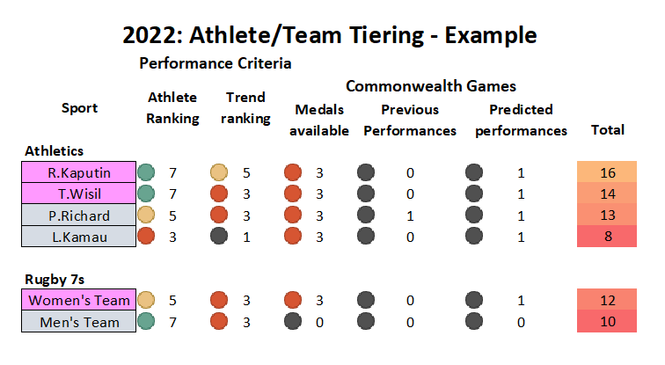
Performance Evaluation Scoring – Team 2022 Scoring Summary (Example)
Individual sports
Scoring for each athlete for each event
Team Sports
- Scoring for each team

Slide 128
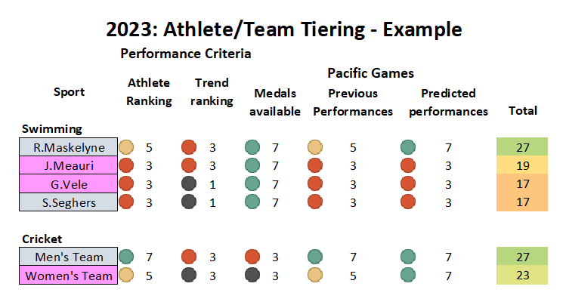
Performance Evaluation Scoring – Team 2023 Scoring Summary (Example)

Slide 129
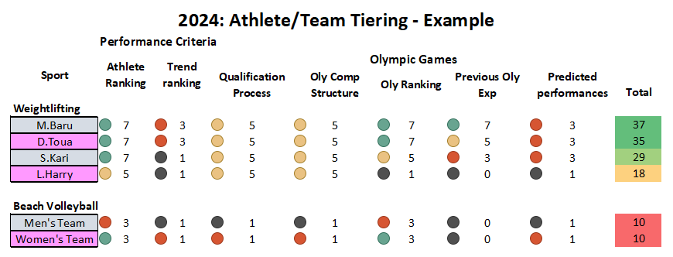
Performance Evaluation Scoring – Team 2024 Scoring Summary (Example)

Slide 130
Governance/Management Factors
Over time, these factors will evolve into determining factors into the ranking of NFs.
Evaluation criteria | Broad description of elements that can be included in this criteria
Coaching | This should describe the level of coaching and experience in place (or proposed) the athletes or teams.
Daily Training Environment | This should describe the location and quality of individual athlete’s and/or a team’s training environment including details about facilities, access to S&C, access to other non-sport specific training modalities, Sport Sciences/Sports Medicine services, relevant access fees etc.
High Performance Plan | This should describe the quality of the NF’s high performance plan in relation to PNGOC minimum standards and template(s) as well as the ability of an NF to deliver the plan based on historical evidence and future potential
Competition | This should include factors such as presence or absence of good quality and regular domestic competition and/or ability to access high level international competition.
Sports Science / Sports Medicine / Technology | This considers whether SS/SM services and appropriate ‘applied sport technology’ in necessary areas are available and/or utilized.

Slide 131
ACTIVITY
ACTIVITY
NF and Athlete/Team tiering system:
Using your targeted list of athletes.
Start tiering them using the scoring template provided
Individual sports – Tier by event
Teams – Tier each team

Slide 132
Resource Allocation Policy – Tier 1
TIER 1 – Team 2024 (Top ATHLETES/TEAMS) / Team 2023 (SI2023 Predicted Gold medalists)
Competition and Training Camp support | Coaching | Athlete Support | Sport Sciences/Sports Medicine (SS/SM) (primarily through HPS)
Up to 3 international or domestic competitions including mandatory qualification competition Domestic competition support. Up to 2 domestic training camps and 1 international training camp (in conjunction with an international competition event) | Coaching support – ranging from international consultant coach advisor to full time coaching support Support to attend competition | Monthly stipend for qualifying targeted athletes (Note: this may be limited to the highest ranked teams or athletes in conjunction with other PNGOC programs and highly dependent on available funds and/or sponsorship Support to attend training camps. Attend domestic competitions | Access to core SS/SM services (e.g. pre-season medical, testing, injury prevention and management, services, massage, other services Medical support and relevant Sport Sciences support at domestic camp or competition and/or up to 2 international competition.

Slide 133
Resource Allocation Policy – Tier 2
Tier 2 - Team 2023 (SI2023 Predicted Podium finishes)
Competition and Training Camp support | Coaching | Athlete Support | Sport Sciences/Sports Medicine
Up to 2 international and domestic competitions including mandatory qualification competitions Domestic competition support. 1 domestic training camps and 1 international training camp (in conjunction with an international competition event) | Limited coaching support e.g. small stipend, funds to attend limited competition | No monthly stipend | Basic Sports Medicine support – e.g. injury management, pre-season screening (primarily through HP Sport) Medical support and relevant Sport Sciences support at domestic camp or competition and 1 international competition,

Slide 134
Resource Allocation Policy – Tier 3
Tier 3 - Team 2023 (SI2023 – No Podium finish)
Competition and Training Camp support | Coaching | Athlete Support | Sport Sciences/Sports Medicine
Only mandatory international qualification competitions Domestic competition support | No coaching support (i.e. direct funding to pay for coaching) | No monthly stipend. Limited support for domestic training camps or programs | No SS/SM support Basic screening and fitness testing. FMS

Slide 135
Resource Allocation Policy – Tier 4
TIER 4 - Development
Competition and Training Camp support | Coaching | Athlete Support | Sport Sciences/Sports Medicine
Domestic competition support only | No direct financial coaching support Support and priority for coach development through OSEP and other relevant coach development programs | No monthly stipend | No SS/SM support Basic screening and fitness testing. FMS

Slide 136
Games Planning Workshop
NF Funding request form
Notes:
Will go over data related to appeals received. Then present issues and solutions the JC has identified and finish with sharing the proposed revised JC process maps for 2023 Pacific Games.

Slide 137
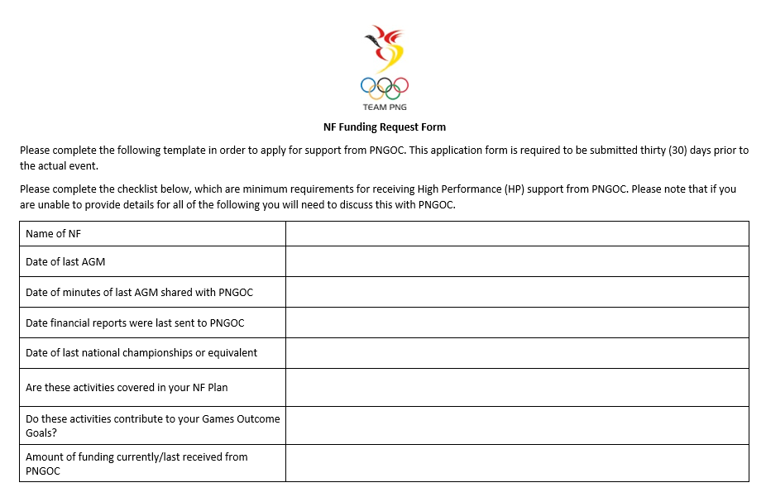
NF Funding request form
Must be compliant with PNGOC Audit of Compliance

Slide 138
NF Funding request form
Form is completed and submitted AFTER your NF, athlete or team has been allocated resources.
Must be submitted with requirements 30 days prior to start of activity
Must indicate the contribution made by the NF to this activity
Activity requested to be supported MUST be in your NF HP Strategic Plan

Slide 139
NF Funding request form - Requirements
The following documents are required to be submitted along with this application 30 days prior to start of the activity:
Detailed Budget
Schedule or Program for the activity (s) related to this application
List of individuals involved
Invoices / Quotes required for payment (Note: Where the cost is above K5, 000, three (3) invoices are required. Should it not be possible to provide three invoices, a suitable justification as to the circumstances should be provided).

Slide 140
Games Planning Workshop
Workshop wrap up
Notes:
Will go over data related to appeals received. Then present issues and solutions the JC has identified and finish with sharing the proposed revised JC process maps for 2023 Pacific Games.

Slide 141
Workshop recap
Understanding the Key Focus Areas for PNGOC’s Strategic Plan
Understand the process of tiering your athletes/teams
Understand how resources are allocated
Understand the guidelines around developing your HP Strategy
Understand the guidelines around developing your sports specific selection criteria
Understand what you need to do, to be able to access the resources
Notes:
470

Slide 142
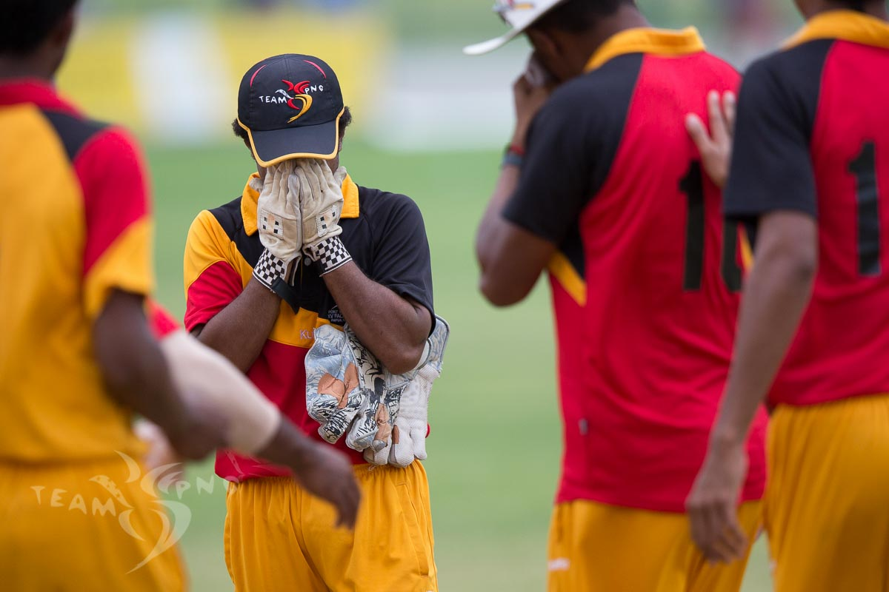
“A year from now you wish you had started today”
Karen Lamb

Slide 143
“IT’S NOT EVERY FOUR YEARS, IT’S EVERYDAY”

Slide 144
Games Planning Workshop
Thank You!

Slide 145
THANK YOU
Available for download on the PNGOC Website or scan the following QR code

